Slide 1

Generic Collections & Data Structures
Andrew Castro

Slide 2
Difference Between Array, ArrayList, LinkedList
Array | ArrayList | LinkedList
An Array is an ordered list of items of the same data type. Use an Array when you know exactly how many items are going to be stored. Arrays has elements that correspond to its index. Index 0 is where the first element is held. | Similarly to an array, an ArrayList is like an array whose size can grow or shrink as need, unlike arrays who have a fixed size Use an ArrayList when you don’t know how many items will be stored in an array. Also, best used when needing to randomly access elements | A LinkedList is an ordered collection of data that has a head(beginning) and tail (end). Best used when you have ordered data, need to remove or add at the beginning or end of collection. Not the best at accessing random values

Slide 3
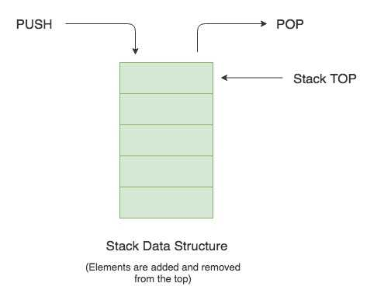
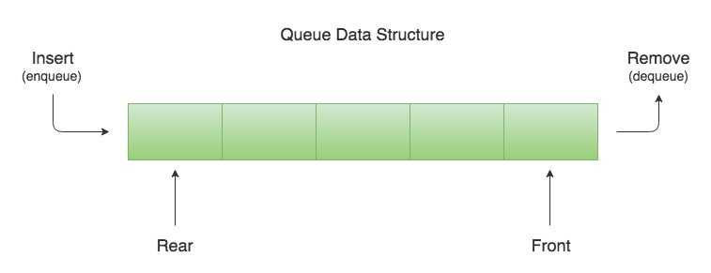
Difference Between Stack and Queue
Stack (LIFO) | Queue(FIFO)
-A Stack is a data structure that utilizes a "Last In, First Out" system, meaning the most recently added value will be the first to be removed from stack. Use when working with tasks that involve backtracking or in reverse order Push to add Pop to remove | -Unlike the Stack, a Queue is a data structure that utilizes a "First In, First Out" system, meaning the first value to enter is the first to be removed. Use when working with data in given order Add to add to queue Remove to remove from queue

Slide 4
Difference Between Array and HashTable
Array | HashTable
Arrays are useful when you need to store a fixed number of elements of the same type, access them by index and iterate them in order. Arrays hold the same type and only one value per index. For example, Arrays can hold an array of strings, an array of integers, an array of characters, etc., but only one data type per array | HashTables are ideal when you need to store a variable number of elements of different types, access them by key and perform frequent insertions and deletions. Each key can hold multiple values For example: HashTable can hold strings and integers together in one data structure

